Slide 1
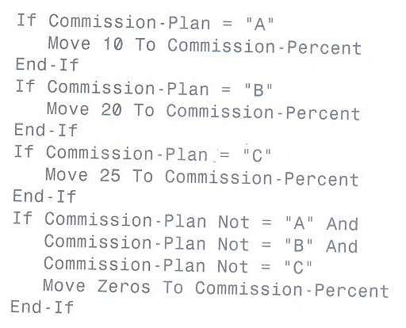
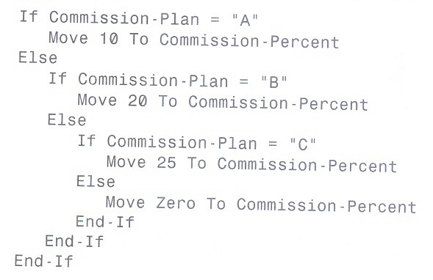




Nested If Statement
FEU – EAST ASIA COLLEGE
Information Technology Department

Slide 2
EVALUATE Statement
The code that immediately follows the word Evaluate is known as the selection subject which defines what you are testing, or evaluating.
You may evaluate an expression, a literal, or a data item, for a true condition, or for a false condition.
The text that follows the word When is defined as the selection object which is evaluated against each selection subject.

Slide 3


EVALUATE Statement

Slide 4
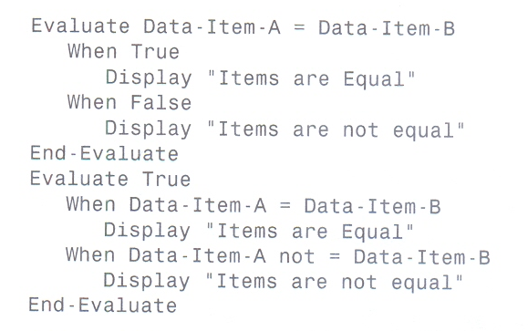
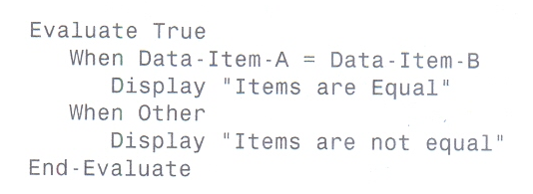

Slide 5
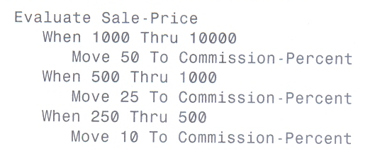


Slide 6
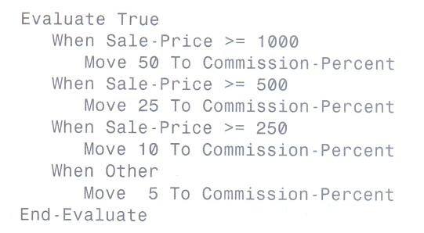

Slide 7
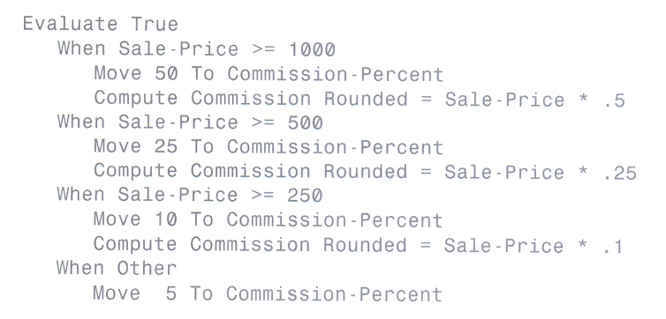


Slide 8
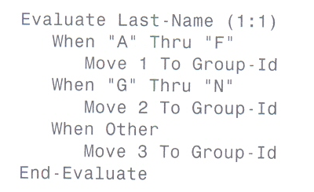
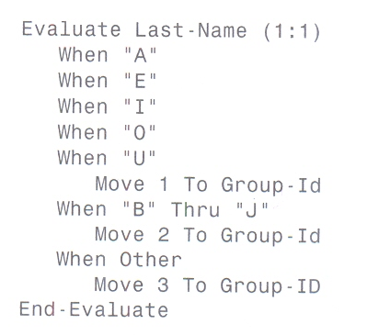

Slide 9
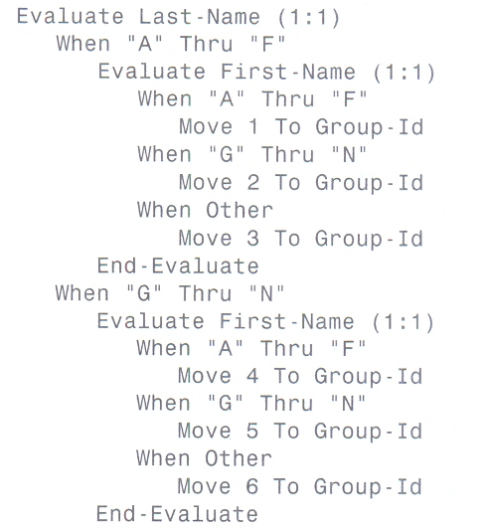
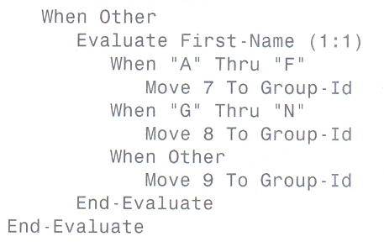

Slide 10
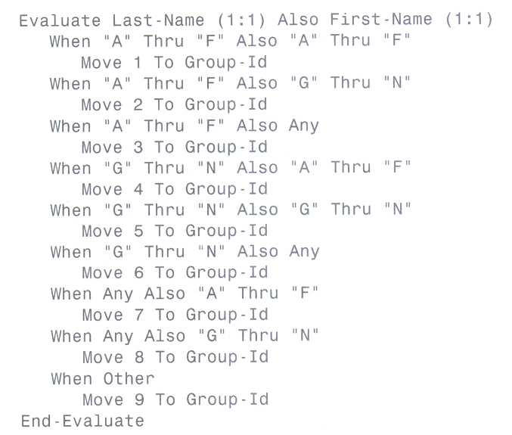

Slide 11
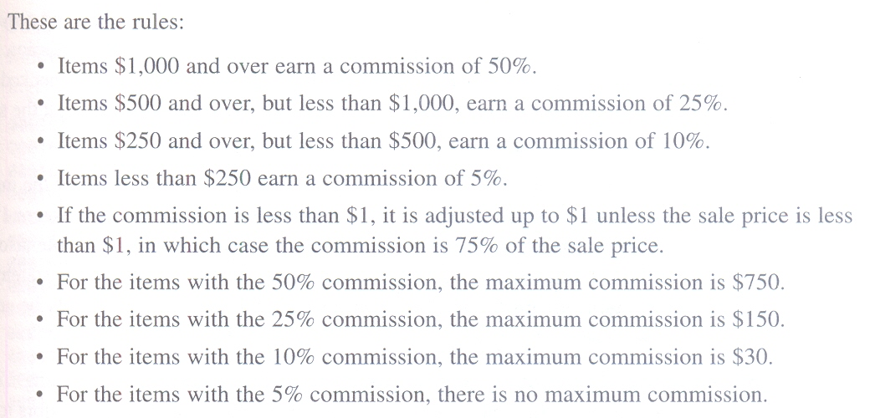

Slide 12
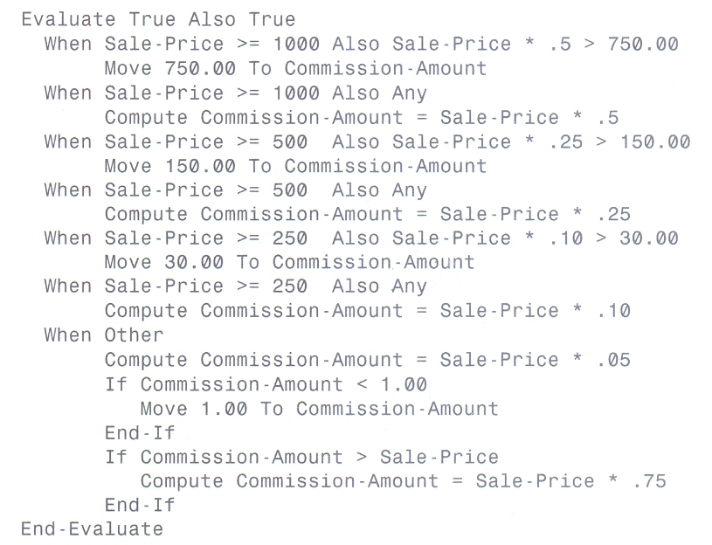

Slide 13
